Slide 1
NOESIS 2K18

Slide 2
INTRODUCTION
Python is a general-purpose interpreted, interactive, object-oriented, and high-level programming language. It was created by Guido van Rossum during 1985- 1990. Python is named after a TV Show called ‘Monty Python’s Flying Circus’ and not after Python-the snake.
Python 3.0 was released in 2008.

Slide 3
Why use Python?
Simple syntax: easy to learn and remember
Portable
Flexible
Large standard library
Short development time
Lots of 3rd party tools/add-ons
Many good implementations:
CPython, PyPy, IronPython, Jython
Active open-source community
Versions: 2.7.x, 3.4.x
Notes:
3

Slide 4
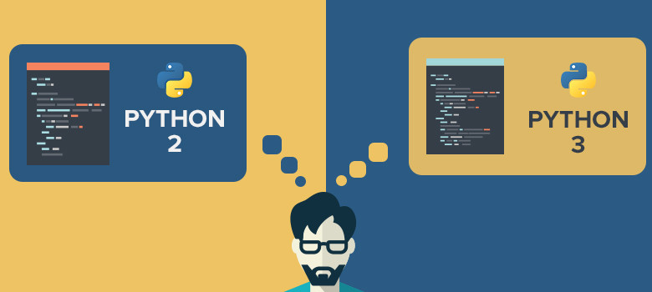

Slide 5
Differences Between Python 2 and Python 3
In Python 2, “print” is treated as a statement rather than a function. There is no need to wrap the text you want to print in parentheses, altPython 3 explicitly treats “print” as a function, which means you have to pass the items you need to print to the function in parentheses in the standard way, or you will get a syntax error.hough you can if you want.

Slide 6
Division operator
print 7 / 5
print -7 / 5
Output in Python 2.x
1
-2
Output in Python 3.x :
1.4
-1.4
In Python 2, implicit str type is ASCII. But in Python 3.x implicit str type is Unicode.

Slide 7
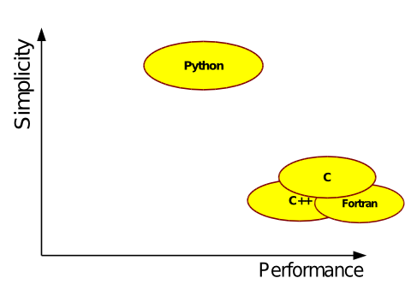
Python vs C/C++

Slide 8
Hello, World!
C
Python
python 3
python 2
#include<stdio.h>
int main(){
printf(“Hello, World”);
return 0;
}
print("Hello, World”)
print "Hello, World"

Slide 9
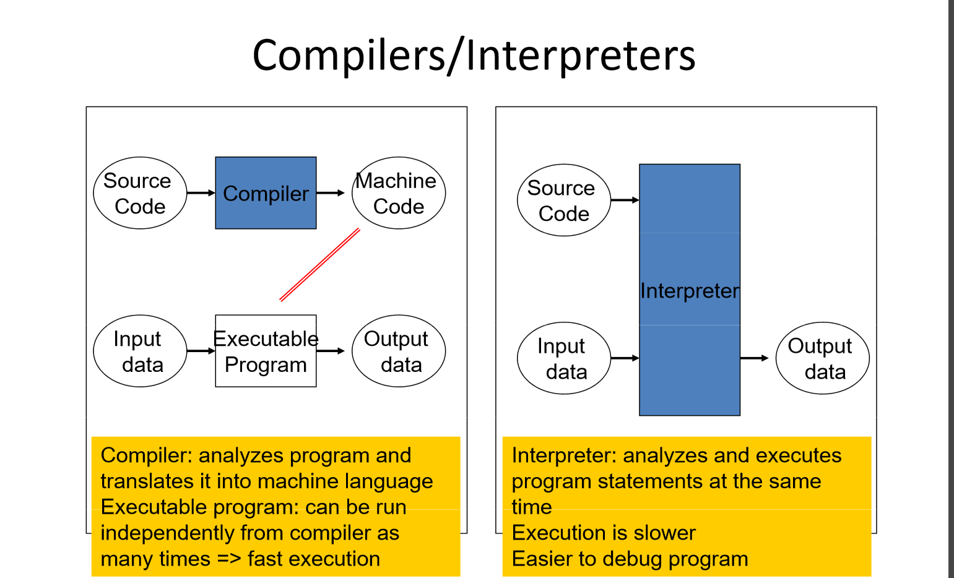
Compiler vs Interpreter

Slide 10
Shell and Editor

Slide 11
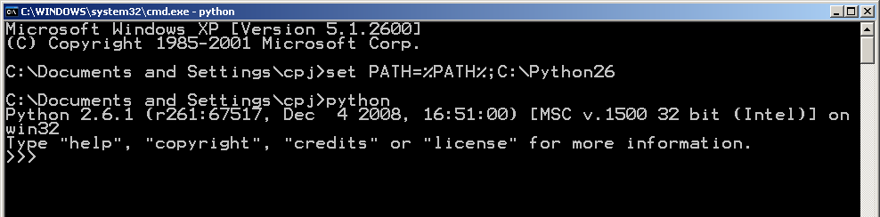
Getting Started
Download from: http://python.org/
Add python to PATH to run scripts from command line
Python is available for most platforms, even mobile.
Most Linux distributions have Python as package(s)
Notes:
11

Slide 12
Variables
name x means 23
>>> x = 23
>>> print(x)
23
>>> x = 'foo'
>>> print(x)
foo
>>> del x
>>> print(x)
Traceback (most recent call last):
File "<stdin>", line 1, in <module>
NameError: name 'x' is not defined
>>>
now it means 'foo'
x is undefined

Slide 13
Numeric Types
Integers
Generally signed, 32-bit
Long Integers
Unlimited size
Format: <number>L
Example: 4294967296L
Float
Platform dependant “double” precision
Complex
Format: <real>+<imag>j
Example: 6+3j

Slide 14
Strings
A sequence of characters enclosed in quotes
3 ways to quote strings:
'Single Quotes'
"Double Quotes"
"""Triple Quotes""" or '''triple quotes'''
Triple quotes can span multiple lines
Examples
>>> print('This string may contain a "')
This string may contain a "
>>> print("A ' is allowed")
A ' is allowed
>>> print("""Either " or ' are OK""")
Either " or ' are OK

Slide 15
Type Conversions
int(), float(), str(), chr(), ord()
int(2.3)
int('5')
int('666')
chr(65)
ord(‘A’)
float(2)
float('234')
float('123.123')
str(1)
str(2.8)

Slide 16
Type Conversions
Functions to convert between types:
str() int() float() complex() bool()‏
>>> str(0.5)‏
'0.5'
>>> float('-1.32e-3')‏
-0.00132
>>> int('0243')‏
243
>>> int(123456000*789101112000)‏
974205123072000000
>>> bool('hi')‏
True
>>> bool('False')‏ # any non-zero, non-null is true
True
Notes:
16

Slide 17
type determines type of Object
Determine the type of an object
Syntax: type(object)‏
Examples
>>> type(2.45)‏
<type 'float'>
>>> type('x')‏
<type 'str'>
>>> type(2**34)‏
<type 'long'>
>>> type(3+2j)‏
<type 'complex'>
Notes:
17

Slide 18
Using comments in a program
Comment statements are used in a program to document it and to enhance its readability.
Useful for human readers of the program –compiler ignores comments
Comments in Python start with the hash character, #, and extend to the end of the physical line.
A comment may appear at the start of a line or following whitespace or code, but not within a string literal. A hash character within a string literal is just a hash character.
Multiline comments don't actually exist in Python. it is taught that in order to do a multiline comment one should use """triple quotes""". This is wrong.
Triple quotes are not ignored by the interpreter in the same way that a comment is.

